Slide 1

Probability and Data Science
Excel Statistics
Presented by World Data Science Institute

Slide 2
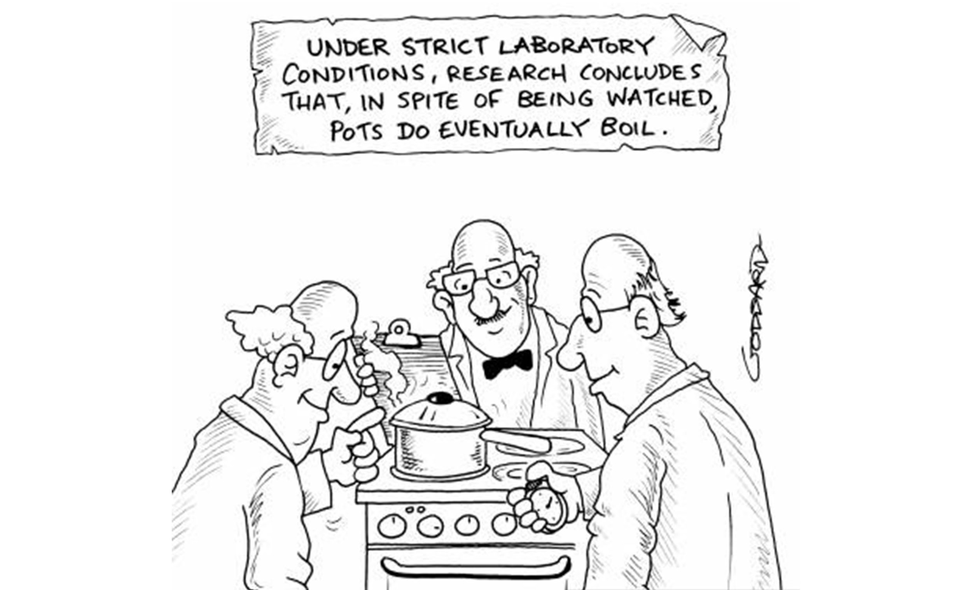
What is Hypothesis Testing?
Testing used to test the validity of a claim

Slide 3
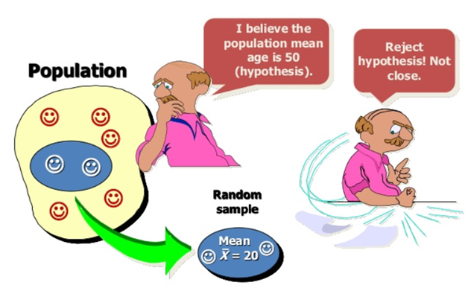
What is a Claim (also known as a Hypothesis)?
A believed statement or educated guess that something is true

Slide 4

Types of Hypothesis: Null Hypothesis and Alternative Hypothesis

Slide 5
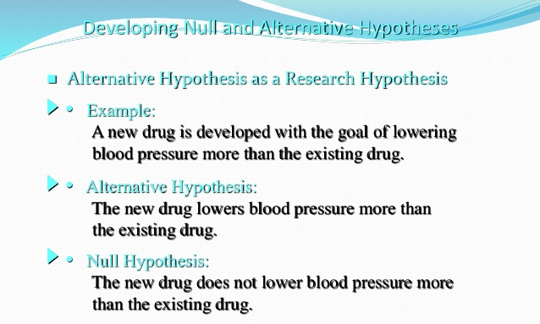
Alternative Hypothesis (also considered Research Hypothesis)
The only function of Alternative Hypothesis is to prove the Null Hypothesis wrong with evidence

Slide 6

Variations of Hypothesis: Null Hypothesis and Alternative Hypothesis
One - Tailed vs. Two - Tailed Test

Slide 7
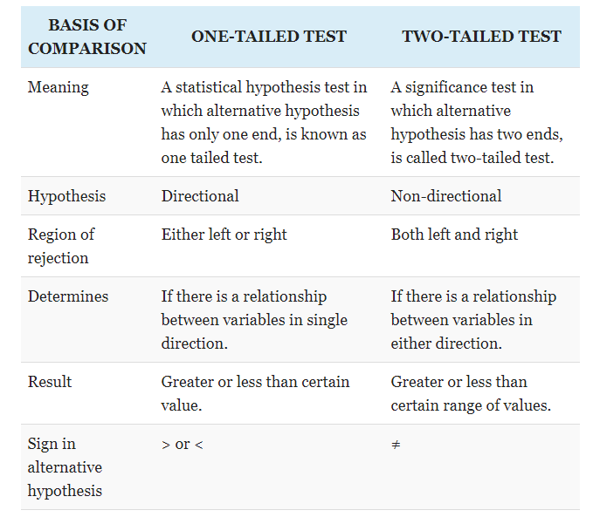
Comparison for One - Tailed vs. Two - Tailed Tests

Slide 8
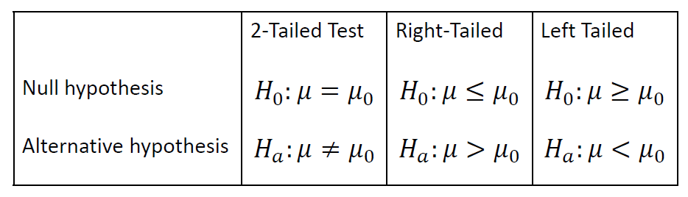
Formulas for One - Tailed vs. Two - Tailed Tests
Population parameter is lower than the assumed one, the hypothesis test is left-tailed.
Population parameter is higher than the assumed one, the hypothesis test is right-tailed.

Slide 9
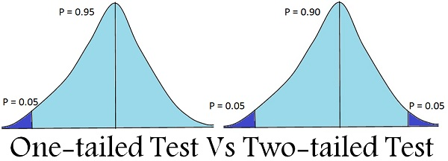
Formulas for One - Tailed vs. Two - Tailed Tests
Population parameter is lower or higher than the assumed one, the hypothesis test is two-tailed.
Two possible answers

Slide 10
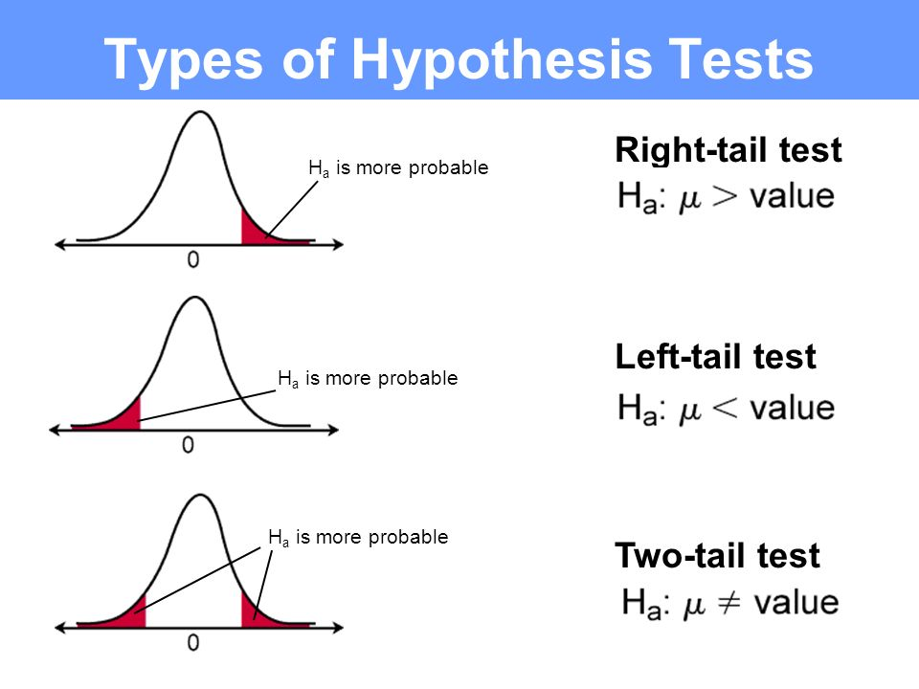
Left - Tailed vs. Right - Tailed Tests

Slide 11
Left - Tailed vs. Right - Tailed Tests
Left-tailed test is also known as a lower tail test. A hypothesis test is performed if the population parameter is thought to be less than the assumed parameter of the null hypothesis.
Right tailed test is also called the upper tail test. A hypothesis test is performed if the population parameter is thought to be greater than the assumed parameter of null hypothesis.

Slide 12
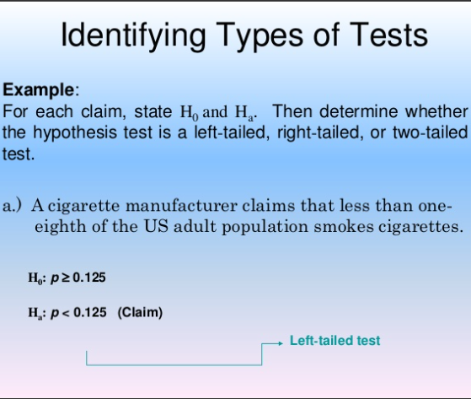
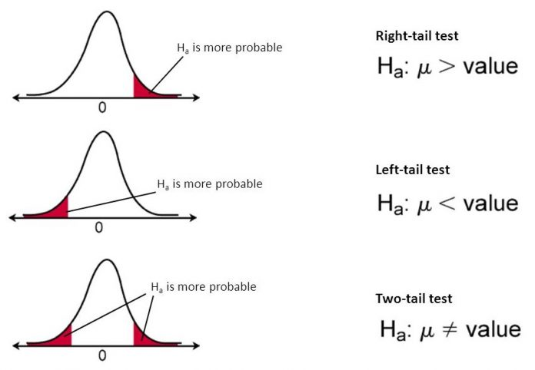
Left - Tailed vs. Right - Tailed Tests
A Greater than symbol would be a right tail test instead of a left tail test.

Slide 13
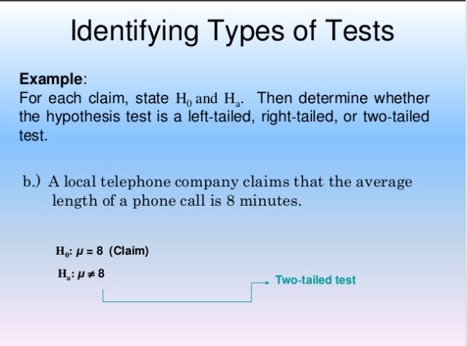
Left - Tailed vs. Right - Tailed Tests vs. Two Tailed Test

Slide 14
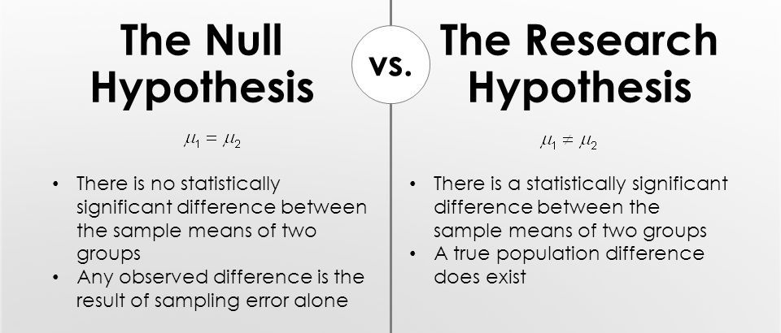
Alternative Hypothesis (also considered Research Hypothesis)
The only function of Alternative Hypothesis is to prove the Null Hypothesis wrong with evidence
H₀: µ₁ (population mean) = µ₂ (population mean of the second group)
Hₐ: µ₁ (population mean) = µ₂ (population mean of the second group)

Slide 15
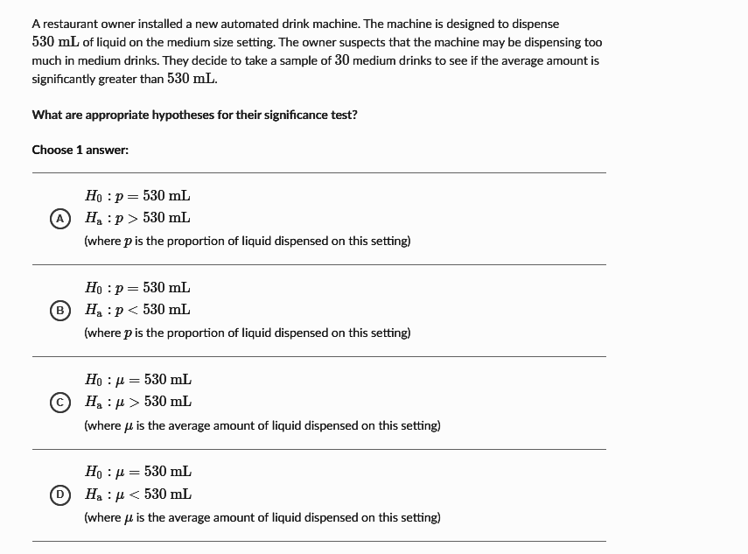
Alternative Hypothesis (also considered Research Hypothesis)
The only function of Alternative Hypothesis is to prove the Null Hypothesis wrong with evidence
Null Hypothesis Formula = H₀: µ₁ (population mean) = µ₂ (population mean of the second group)
Alternative Hypothesis Formula = Hₐ: µ₁ (population mean) ≠ µ₂ (population mean of the second group)

Slide 16
Types of Errors with Hypothesis
Type 1 Error is when the true Null Hypothesis is rejected for a alternative hypothesis
Type 1 Error is called a False Positive
Example: Doctor says you have Cancer and you do not!
Alpha is used with Type 1 Errors
Type 2 Error is not supporting Alternative Hypothesis when it is actually true
Type 2 Error is called a False Negative
Example: Doctor says you do not have Cancer and you do!
Beta is used with Type 2 Errors

Slide 17
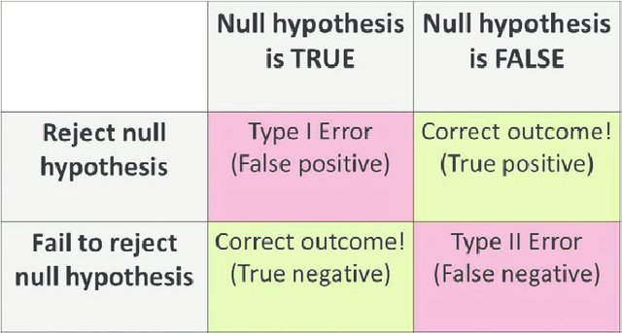
The chart below is called a Confusion Matrix (heavily used in Statistics)

Slide 18
Type 1 Error is when the true Null Hypothesis is rejected for a alternative hypothesis
Alpha (Alpha score or Alpha level) is used to detect the probability of a Type 1 Error
Alpha is measured by the confidence level
To get α subtract your confidence level from 1 (Formula for One Tailed Tests)
For two-tailed tests, divide the alpha by 2 (Formula for Two Tailed Tests)
If the confidence level is 95% (alpha would equal 1 - 0.95 or 0.05)
A p-value of 0.05 means there is a 5% chance of being wrong when using the alternative hypothesis instead of the null hypothesis.

Slide 19
What is a good P-Value?
Probability Value
Shows the strength of the Hypothesis test
High P-Value = .1 very strong evidence supporting claim
High P-Value is greater than .05
Low P-Value = .001 very strong evidence against claim
Low P-Value is less than or equal to .05

Slide 20
Alpha is used in Finance most notably to access Risk
Alpha measures the amount that the investment has returned in comparison to the market index or other broad benchmark that it is compared against
A Benchmark could be S&P 500, Nasdaq, or DOW.
A positive alpha of 1.0 means the fund or stock has outperformed benchmark by 1 percent. A similar negative alpha of -1.0 would indicate an underperformance of 1 percent.
A beta of less than 1 means that the STOCK will be less volatile than the market (A SAFE INVESTMENT)
If alpha is positive, it means that the stock returned more than its expected return, whereas a negative alpha indicates that the stock returned less.

Slide 21
Beta is used with Type 2 Errors
Beta is the measure of Probability of a Type 2 Error (FALSE POSITIVE)
Beta represents the probability that a false hypothesis in a statistical test is accepted as true (FALSE POSITIVE)
Type 2 Error is not supporting Alternative Hypothesis when it is actually true
Example: Doctor says you do not have Cancer and you do!
Beta depends on Sample Size and Population Variance
The probability of committing a type II error is equal to one minus the power of the test, also known as beta. The power of the test could be increased by increasing the sample size, which decreases the risk of committing a type II error (False Positive).
If Type II error is fixed at 3 percent, it means that there are about three chances in 100 that the null hypothesis, H0, will be accepted when it is not true.

Slide 22
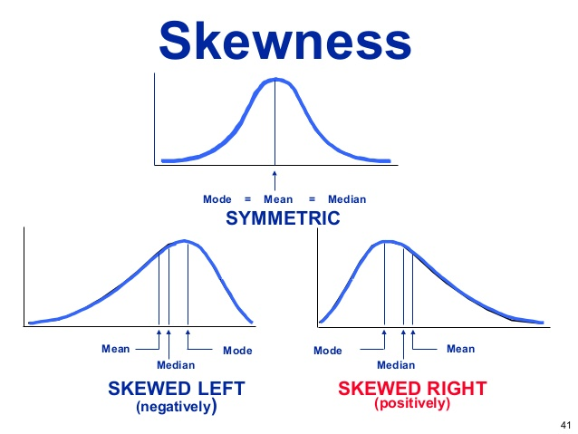
Also the humps we went over already the humps are just what side the distribution go to in a distribution (Middle, left or right)
A positively skewed distribution means there's a "hump" in the data on the left side of the graph.
REMEMBER OR ARE SOME OF YOU GOING TO SAY WE NEVER LEARNED THIS?

Slide 23
Detailed Explanation of Ztable vs Ttable we will discuss this further later!
https://www.statisticshowto.com/tables/z-table/
https://www.statisticshowto.com/tables/t-distribution-table/

